Slide 1



Time Attendance System
Group1:

Slide 2
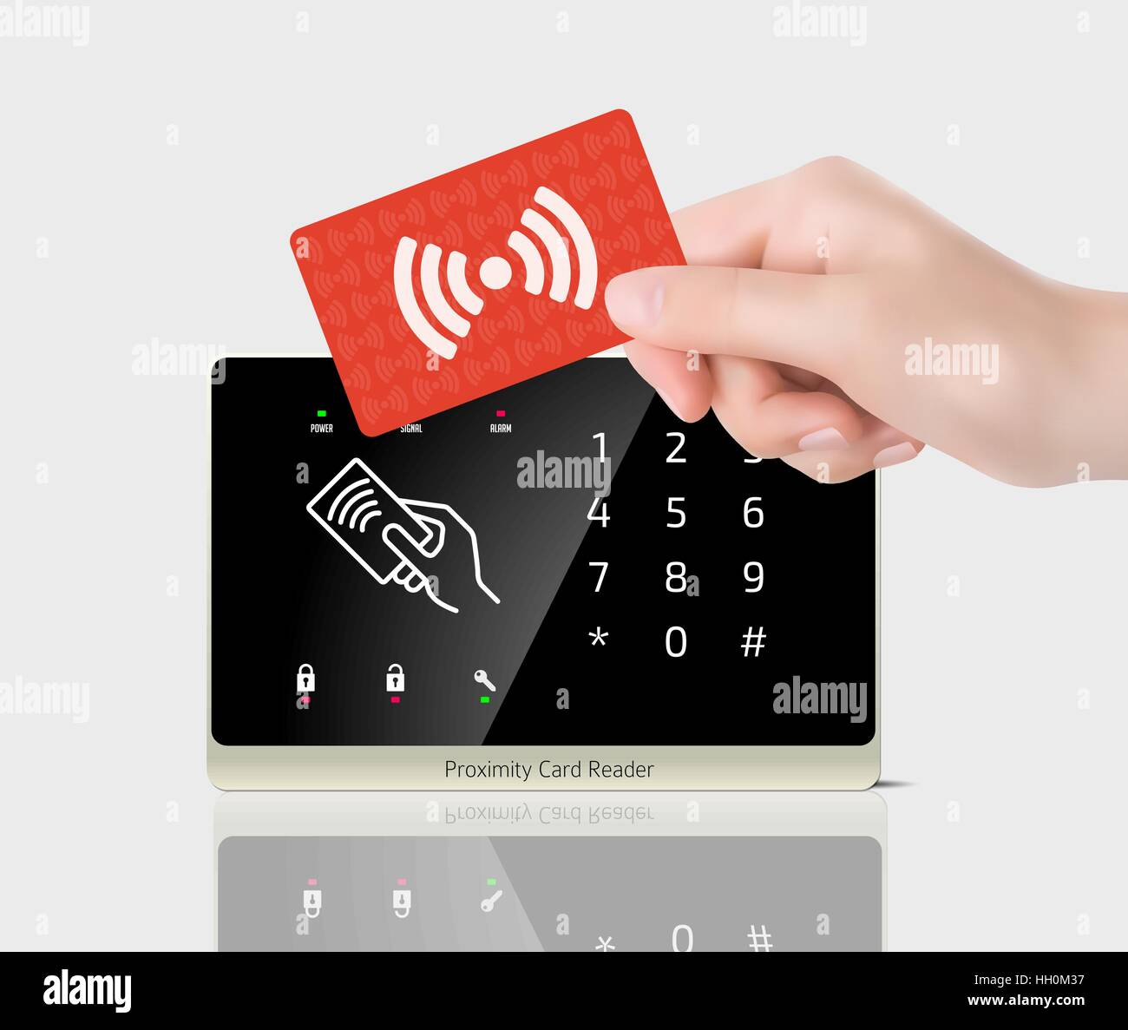
What is it?

Slide 3

Target audience and their needs

Slide 4






System benefits

Slide 5
Electronic components
Name | Cost
Arduino UNO | $5.29
Arduino Starter Kits | $3.80
MFRC522 RFID reader + tags | $0.30
SD card module | $6.97
Micro SD card | $6,78
SD1307 RTC module | $1.92
2x LEDs (1x red + 1x green) | $8.00*2
2x 220 Ohm resistor | $14.49
Breadboard | $2.26
Jumper wires | $4.63

Slide 6
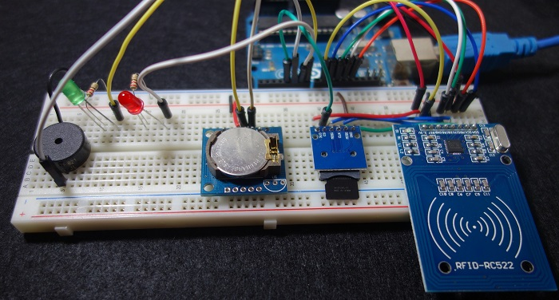
Operating system

Slide 7

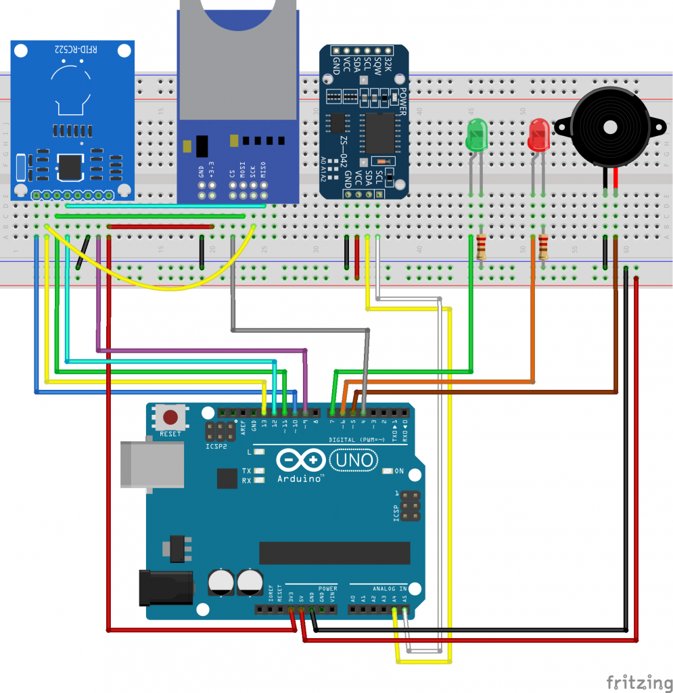
System Diagram

Slide 8
Risk
Power-off
Card not recognized
Damaged equipment

